Slide 1
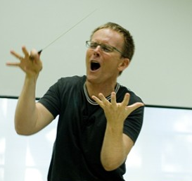
Foundations in conducting
Two sessions
  #1 Saturday August 15, 2-5 pm
  #2 Monday August 17, 6:30-9:30 pm
These classes will include:
  Presentation of basic techniques
  Much practice in class
  Optional assignments to practice between class times
  Bring your conducting problems to second class, or…
  Send them before second class: tholmchor@gmail.com

Slide 2
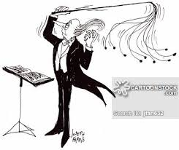
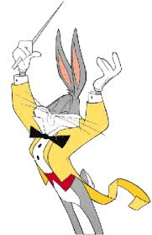
Topics in order
Posture, arm/hand positions
4- and 3-beat patterns
Preparatory gestures
Articulations: legato, staccato, etc.
2- and 1-beat patterns
Dynamic changes gradual: right hand & left hand
Subito dynamic changes
Fermatas

Slide 3
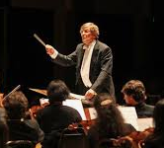
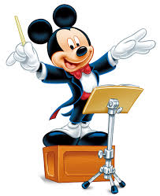
Topic in order (cont.)
Right-hand cues
Left-hand cues
Compound meters
Divided patterns
Changing meters
Tempo changes gradual
Tempo changes subito
Rehearsal paradigm
Knowing the layers of the score: most, less, least important
Your questions: submit before next class or bring
  Send to tholmchor@gmail.com

Slide 4
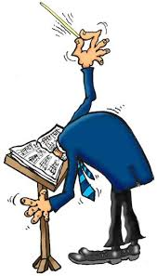
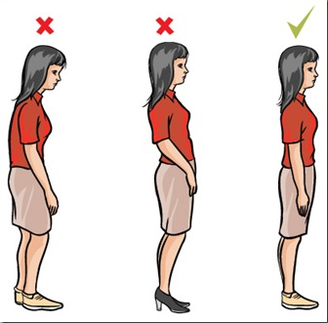
Posture
Conductor’s posture…a model for good singer’s posture
  Tall spine
  Shoulders back
  Tail tucked in

Slide 5
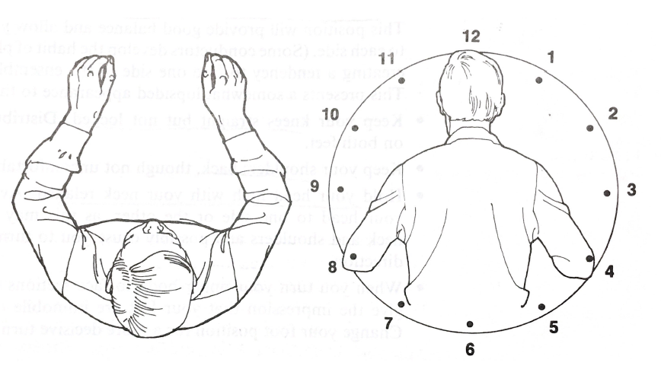
Arm and hand position

Slide 6
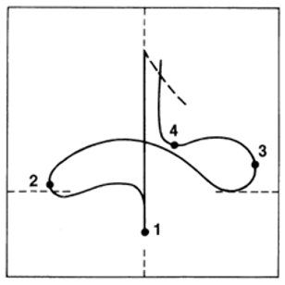
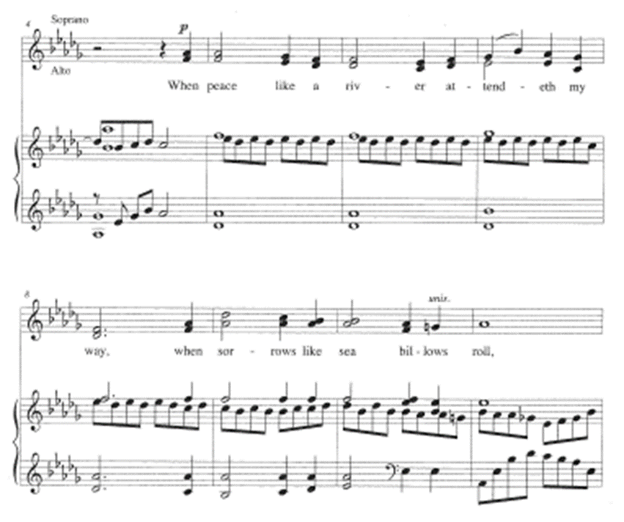
The basic four-beat pattern
Notes:
Also show on white board, including horizontal and vertical planes

Slide 7
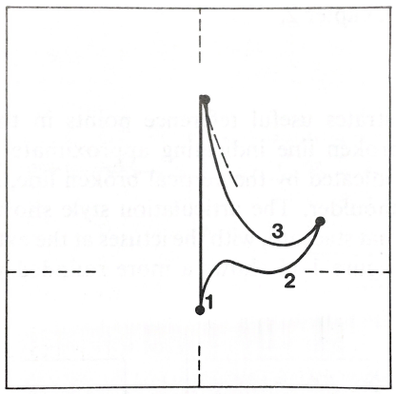
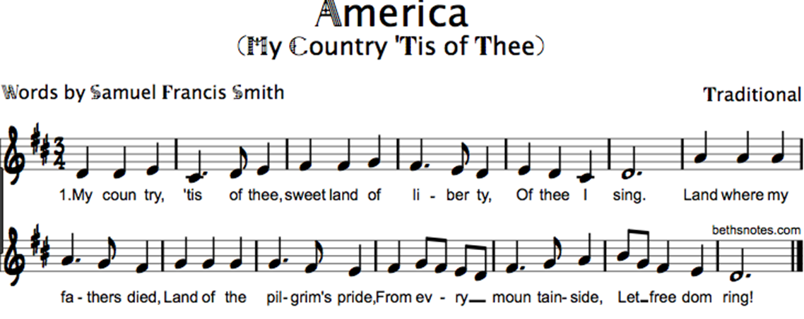
The Three-beat pattern

Slide 8

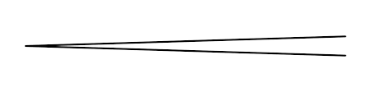


The Preparatory gesture
What should it show?
It should show…
  Exact beginning of the first tone
  Dynamic level
  Articulation: staccato—legato—marcato
  Tempo
Notes:
On white board, feedback from opening question: what should prep show?
Eye contact, hold, clear first gesture accompanied by breath

Slide 9


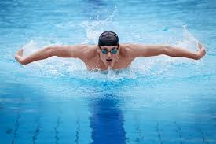
Prep gesture…you need:
Eye contact
Music already playing inside
Attention position: complete stop before prep
Clear gesture showing…
  Tempo
  Dynamic
  Articulation
Visible breath

Slide 10
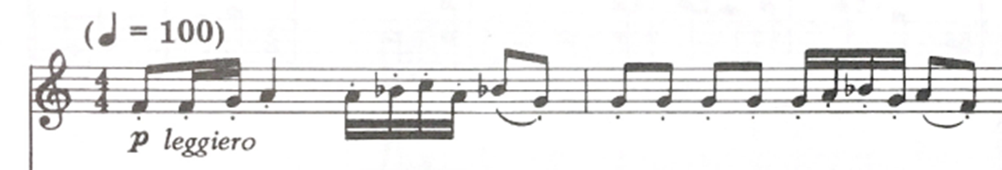
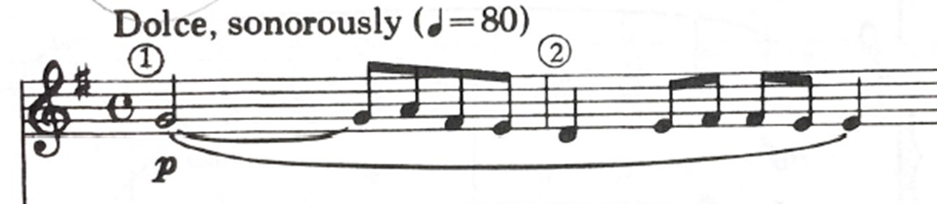
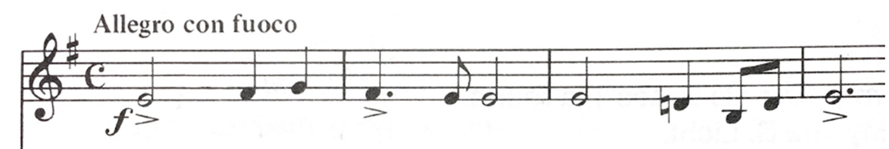
Practice your prep!!

Slide 11
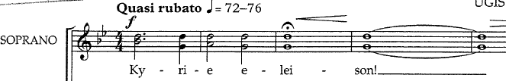

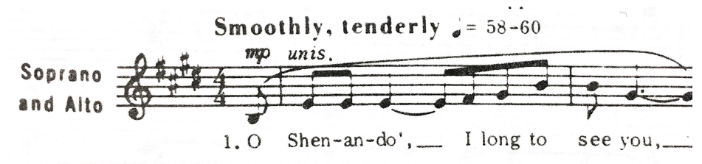
More prep practice!

Slide 12
A few clips of preps for review
https://youtu.be/gxxHr4Bz5No
https://youtu.be/unkrkteJN-0?t=23s
https://youtu.be/ryZTs18yUAo?t=22s
Notes:
Watch each and evaluate for: eye contact, hold position, clarity of intent, tempo
First clip shows unclear prep and no stop/command position
Second is Phillip Brunelle: what IS he showing?
Third clip shows preps at different tempo than piece

Slide 13
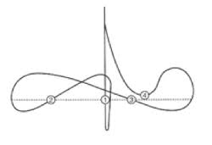
Articulation types: legato
Legato:
  all connected, smooth movement
  Wrist leads slightly

Slide 14
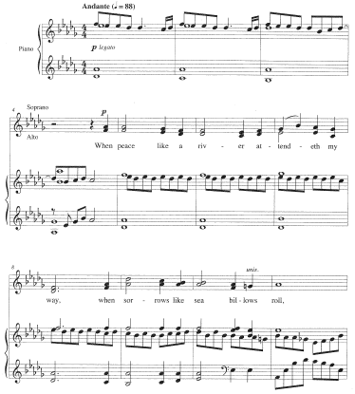
Practice your legato!

Slide 15
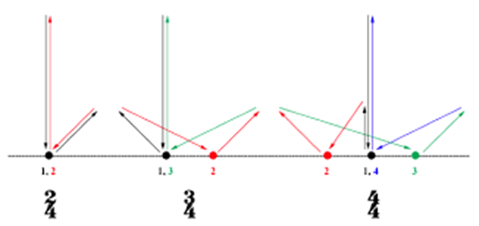
Articulation types: staccato
Staccato:
  Not connected, quick movement, abrupt stop
  Tip of beat “flicks up” on ictus

Slide 16
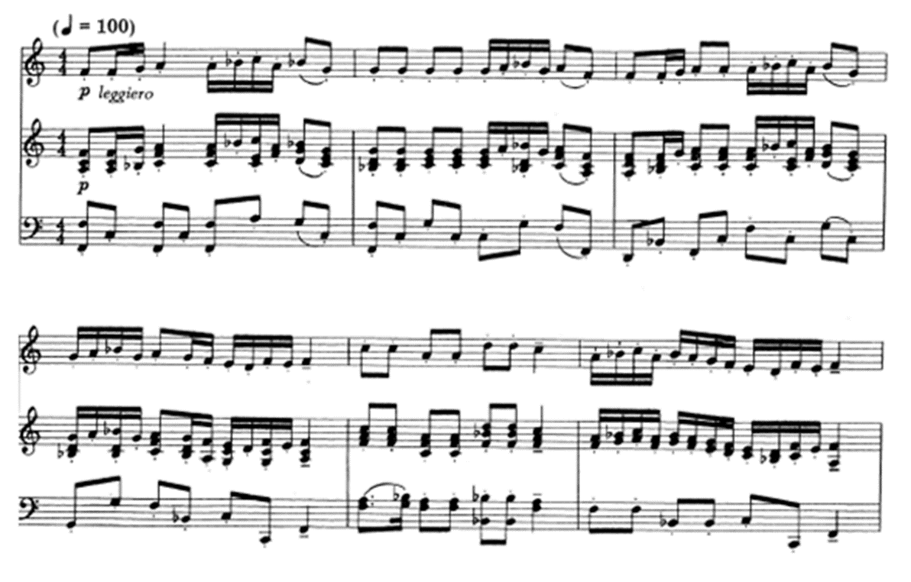
Practice your staccato!

Slide 17
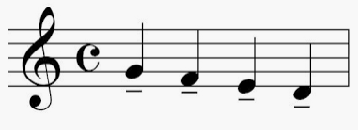
Articulation types: tenuto
Tenuto:
  Heavily connected, horizontal motion
  Wrist leads, fingers follow

Slide 18
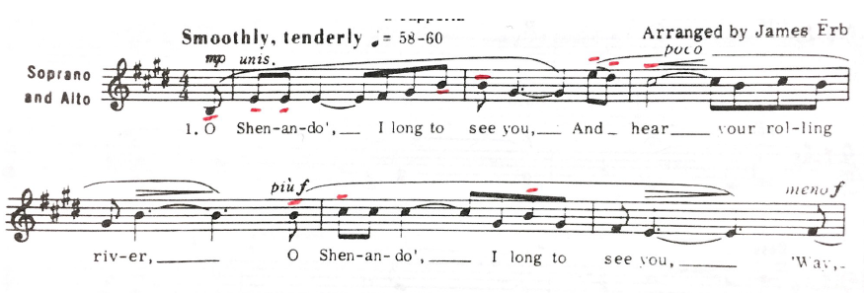
Practice your tenuto!

Slide 19
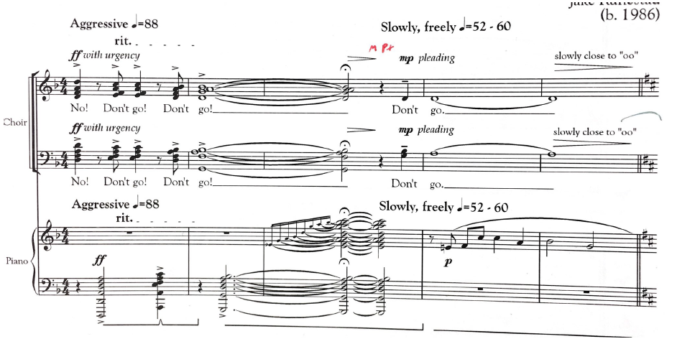
Articulation types: marcato
Marcato:
  Heavy weight, quick but short rebound

Slide 20
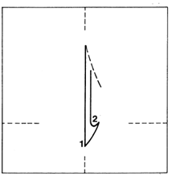

Two-beat patterns
staccato/marcato
Notes:
Note horizontal plane: important for not getting lost. Marching band gesture

Slide 21
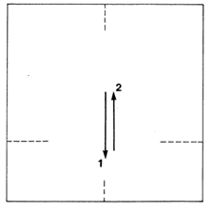

Two-beat patterns
Fast tempos, dry articulation, wrist only

Slide 22
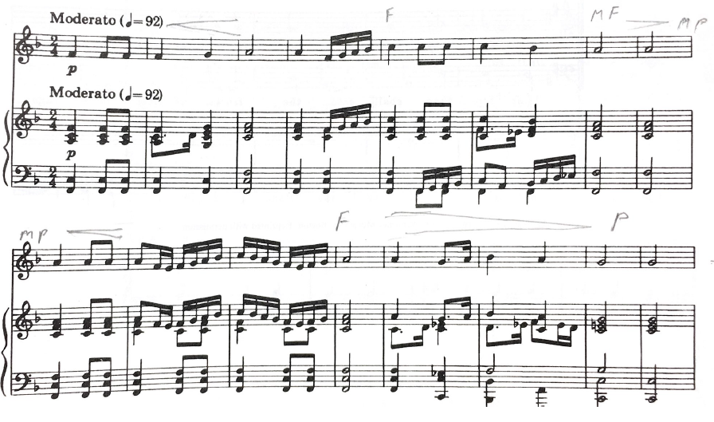
2-beat: slow, legato

Slide 23
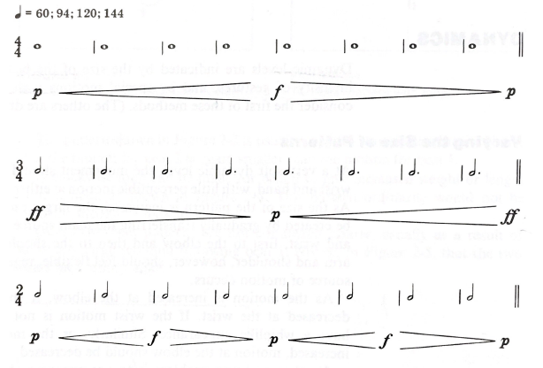
Right-hand dynamics: gradual
Control three joints:
Wrist
Elbow
Shoulder
Notes:
Three joints: wrist, elbow, shoulder

Slide 24

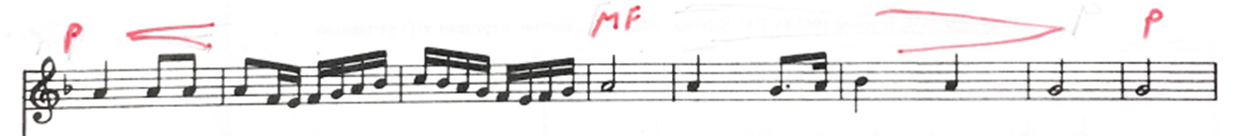
Practice right hand dynamics!

Slide 25
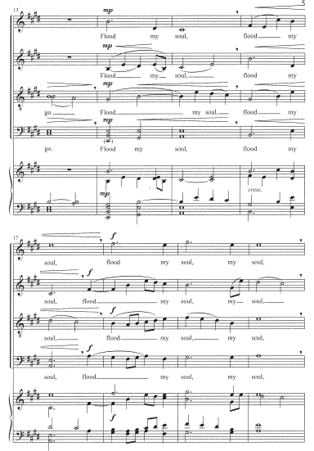
More practice!

Slide 26
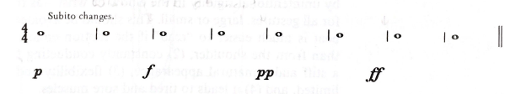
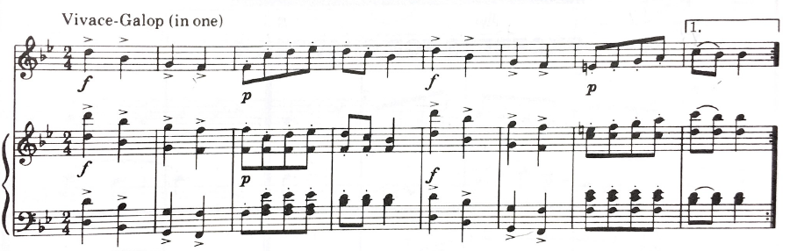
Right-hand dynamics: subito
Notes:
Subito: Where does the change occur?

Slide 27

Left-hand dynamics: gradual

Slide 28
More Practice!
Left Hand dynamics

Slide 29
Left-hand dynamics: subito
Notes:
Subito: Where does the change occur?

Slide 30




Fermatas
Three basic types
  Hold + full stop (caesura):
  Hold + No Breath and continue:
  Hold + cut-off and continue:
  (end of cut = start of prep)
Notes:
Also: 1-2-3-4 1-2-3-4 1-2-3-4 1-2-3-4 on white board, with moving fermata

Slide 31
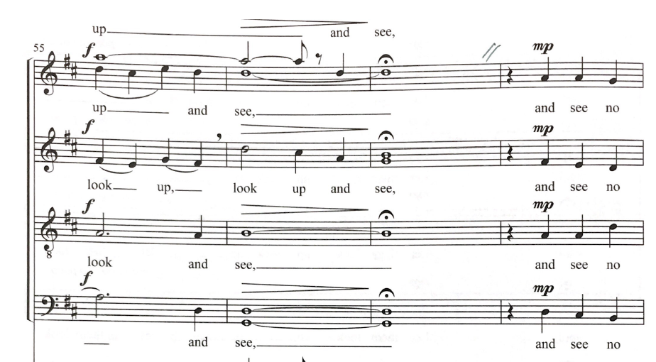
Fermata I: Hold + full stop (caesura)

Slide 32
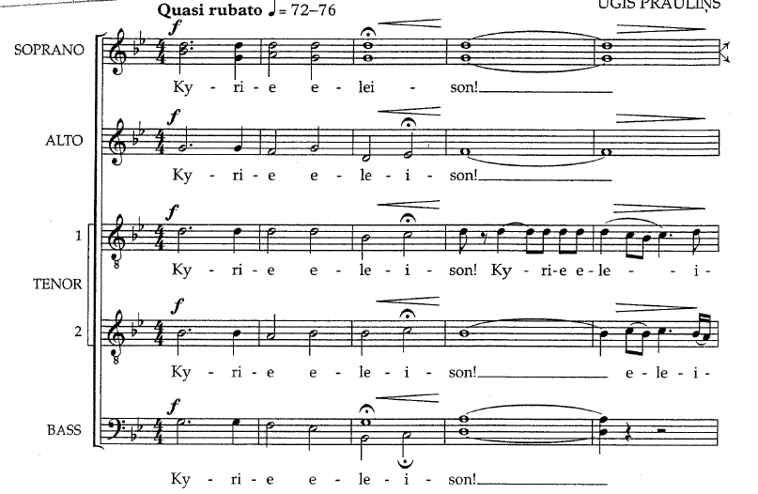
Fermata II: hold but no break

Slide 33
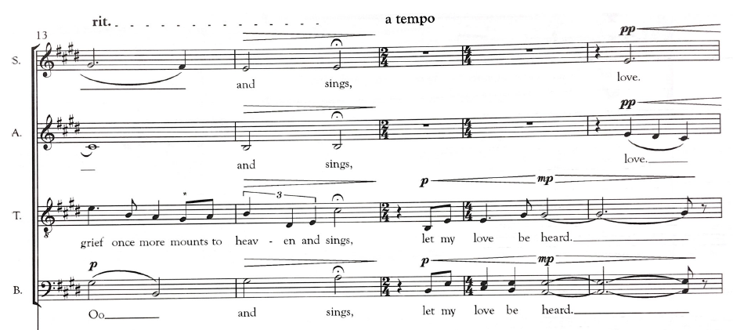
Fermata III: hold + breath in tempo, no pause
Combine cut-off gesture and prep into one fluid motion

Slide 34
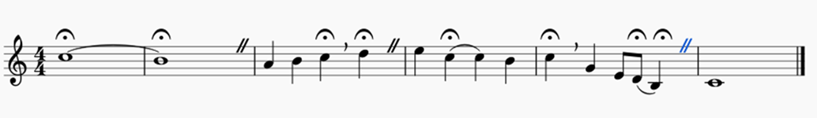
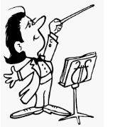
Practice: exercise with all three types

Slide 35
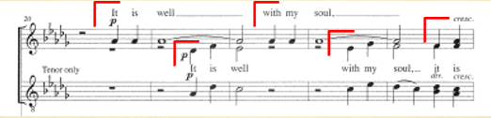
Right-hand cues
Eye contact
Minimize two beats ahead
Prep one beat ahead

Slide 36
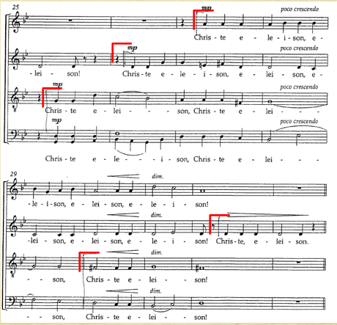
Practice right-hand cues!

Slide 37
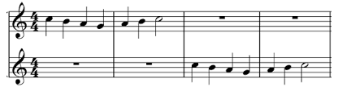


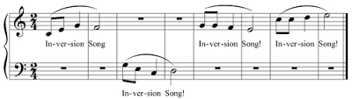
Left-hand cues
  Eye contact
  Left hand at attention two or more beats ahead of cue
  Begin prep one beat early, including breath
  Cue arrives on ictus of new entrance

Slide 38
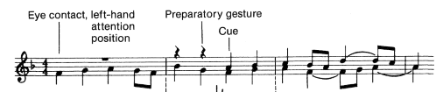
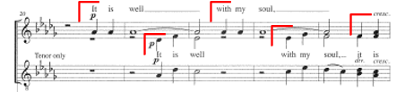
Left-hand cues in real music

Slide 39
Practice left-hand cues!

Slide 40
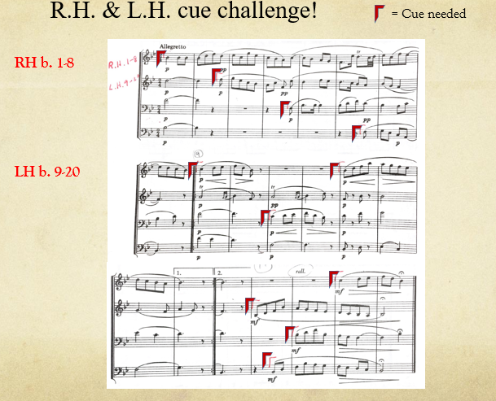
b. 9

Slide 41
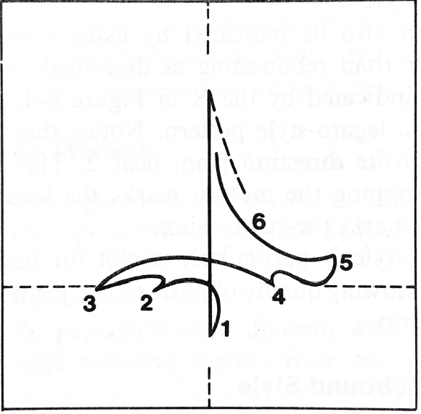
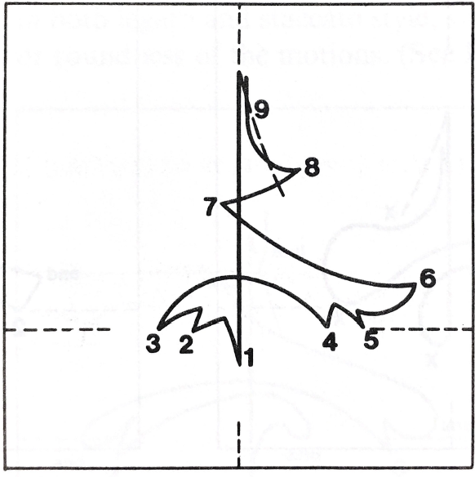
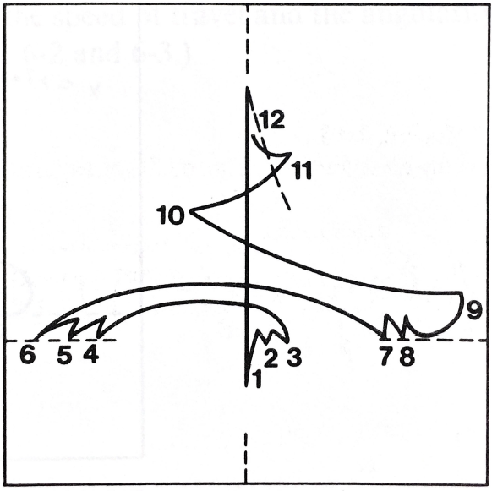
Compound meters (3 division of pulse)
6/8
9/8
12/8

Slide 42
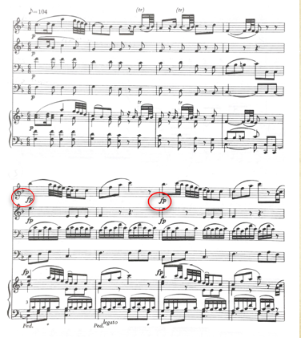
Practice compound meters!

Slide 43



Divided meters
4/4
3/4
2/4

Slide 44

Practice divided meter plus dynamics and cues

Slide 45


Changing meters

Slide 46

Practice meter changes

Slide 47



Tempo changes: gradual

Slide 48

Tempo changes: sudden

Slide 49
Rehearsal paradigm: foundation first
Emotional/intellectual ownership
Expressive nuance
Text
Balance
Rhythm/intonation
Intonation/rhythm

Slide 50

Knowing the score
KNOW every part, every phrase, color
Which part(s) most important, less, least

Slide 51


Knowing the score

Slide 52

Layers: which are most important

Slide 53


Layers: shape and importance

Slide 54
Optional
Your questions
Choral tuning
  The natural overtone series
  “just” vs “equal-temperament” tuning
  Vowels

